Slide 1



Chapter 2
Recursion
Objectives
Upon completion you will be able to:
• Explain the difference between iteration and recursion
• Design a recursive algorithm
• Determine when an recursion is an appropriate solution
• Write simple recursive functions

Slide 2



2-1 Factorial - A Case Study
We begin the discussion of recursion with a case study and use it to define the concept.
This section also presents an iterative and a recursive solution to the factorial algorithm.
• Recursive Defined
• Recursive Solution
In computer science, recursion is a method of solving a computational problem where the solution depends on solutions to smaller instances of the same problem

Slide 3
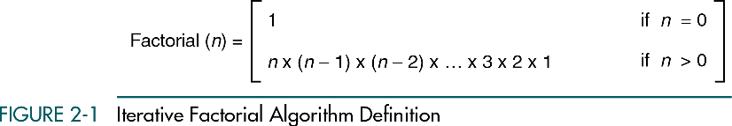

Slide 4
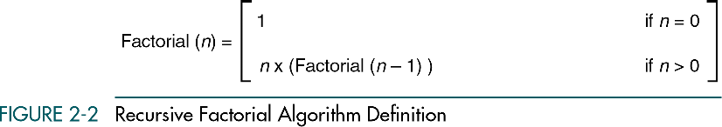

Slide 5
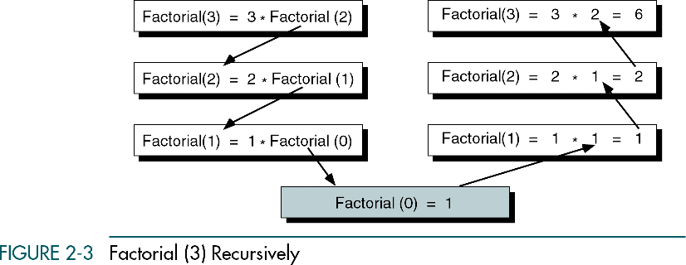

Slide 6
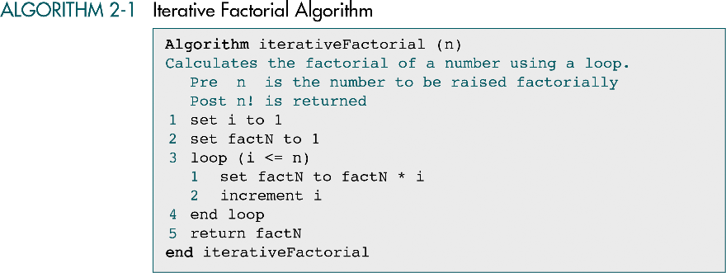

Slide 7
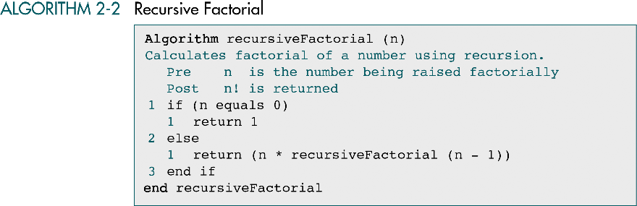

Slide 8
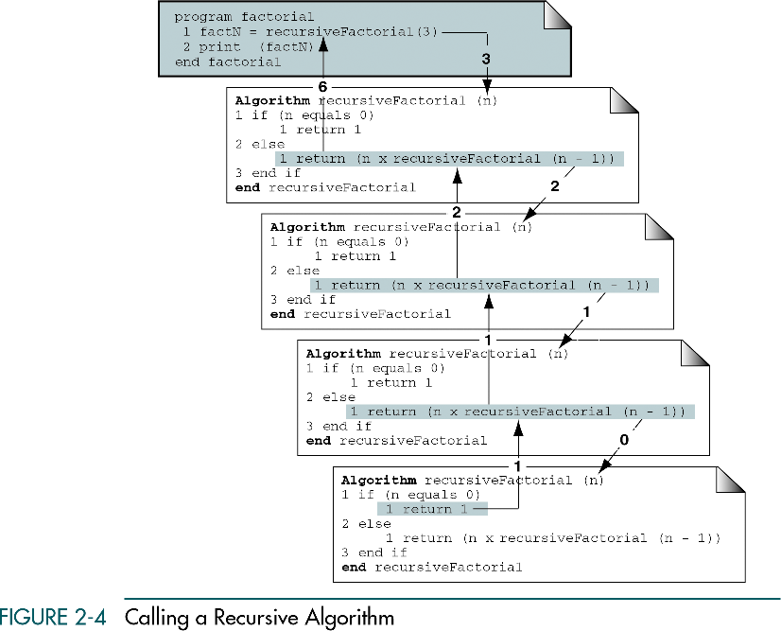

Slide 9



2-2 Designing Recursive Algorithms
In this section we present an analytical approach to designing recursive algorithms. We also discuss algorithm designs that are not well suited to recursion.
• The Design Methodology
• Limitation of Recusion
• Design Implemenation

Slide 10
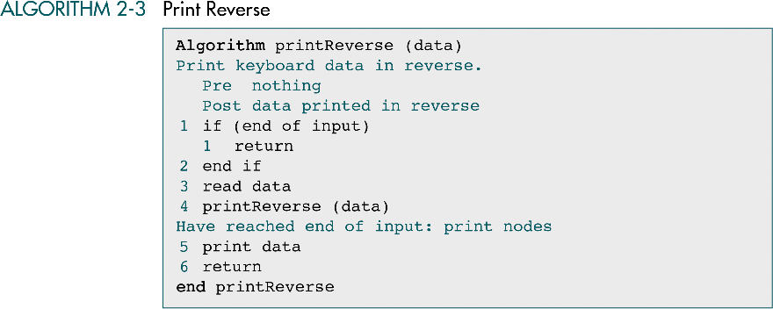

Slide 11
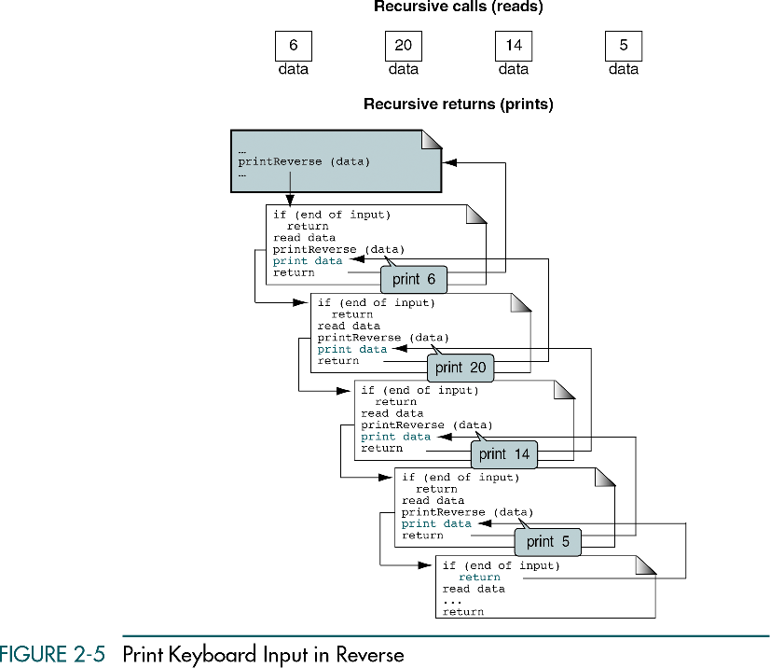

Slide 12
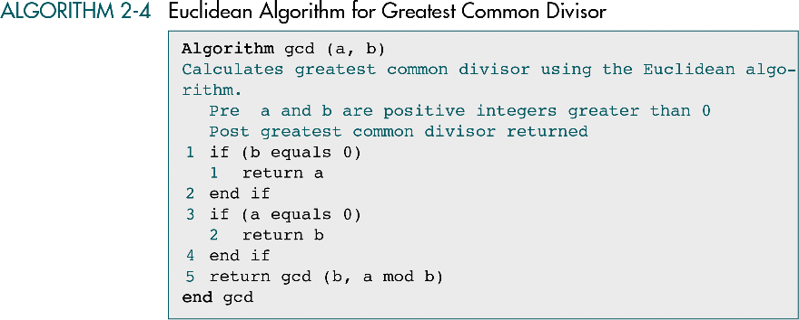

Slide 13
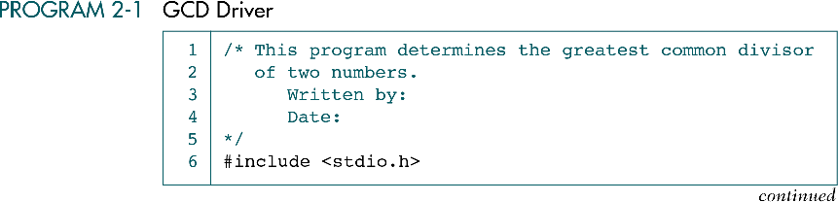

Slide 14
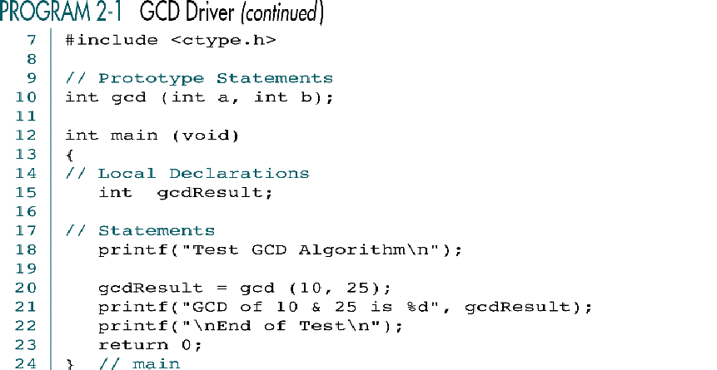

Slide 15
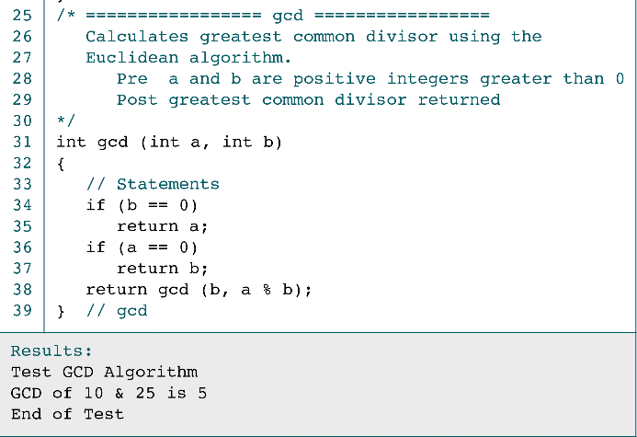

Slide 16
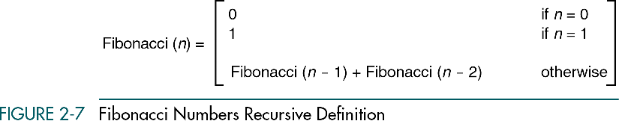
The Fibonacci sequence is a sequence in which each element is the sum of the two elements that precede it 0, 1, 1, 2, 3, 5, 8, 13, 21, 34, 55, 89, 144, ...

Slide 17
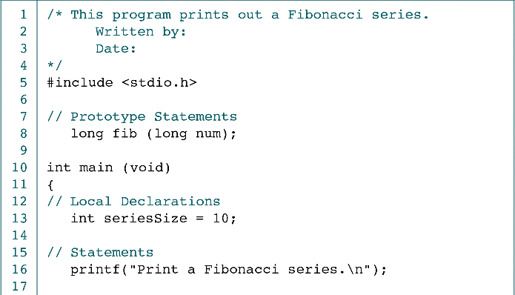

Slide 18
(Continued)

Slide 19
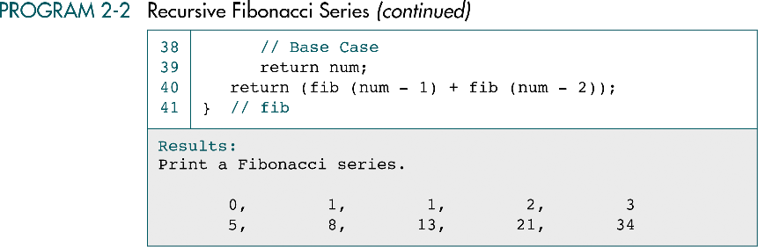

Slide 20
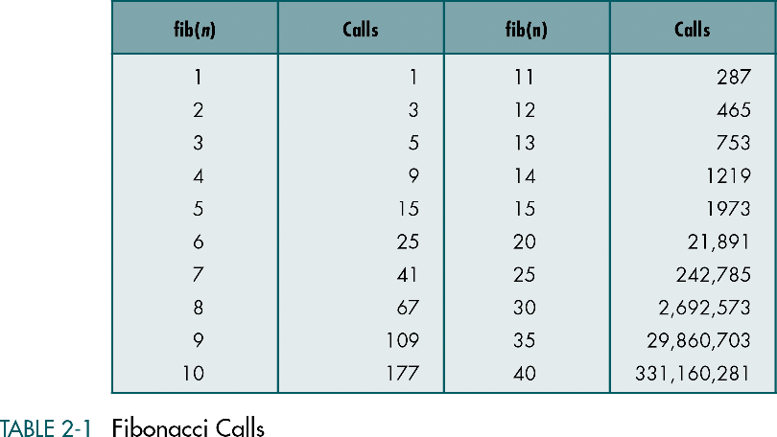

Slide 21
Advantages of recursion?
Reduces the size of the code
More intuitive to solve problems that are inherently recursive in nature.

Slide 22
Disadvantages of recursion?
Greater time requirements
Greater space requirements

Slide 23
When (not) to use recursion?

Slide 24
Examples: Print the reverse of a string

Slide 25
Examples: Determine the length of a string

Slide 26
Examples: Remove all occurrences of a character from a string

